Slide 1

Employee Resignation
Meliza Rodriguez
Harsh Saxena
PM Tamkeen
Term Project Group #3

Slide 2

Introduction

Slide 3
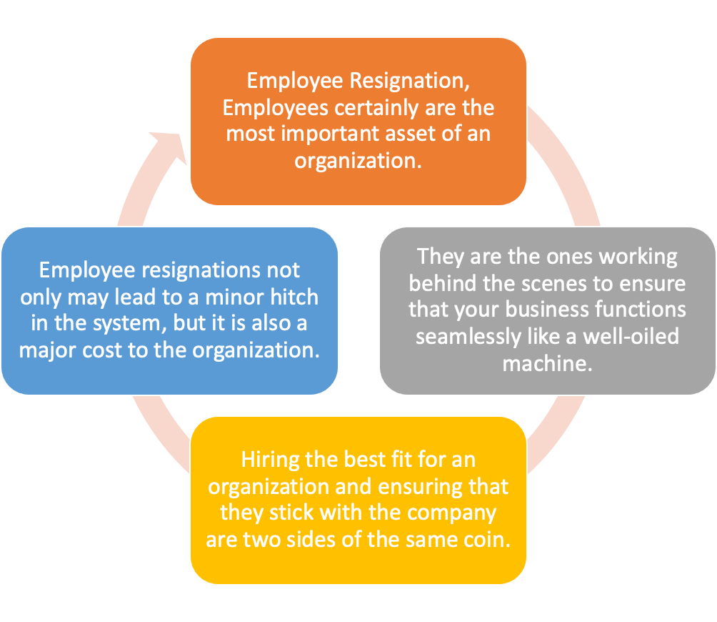
Define the business problem. Why do you think what you work on is important?
Employees are the most important part of an organization. Successful employees meet deadlines, make sales, and build the brand through positive customer interactions.
Employee attrition is a major cost to an organization and predicting such attritions is the most important requirement of the Human Resources department in many organizations.

Slide 4
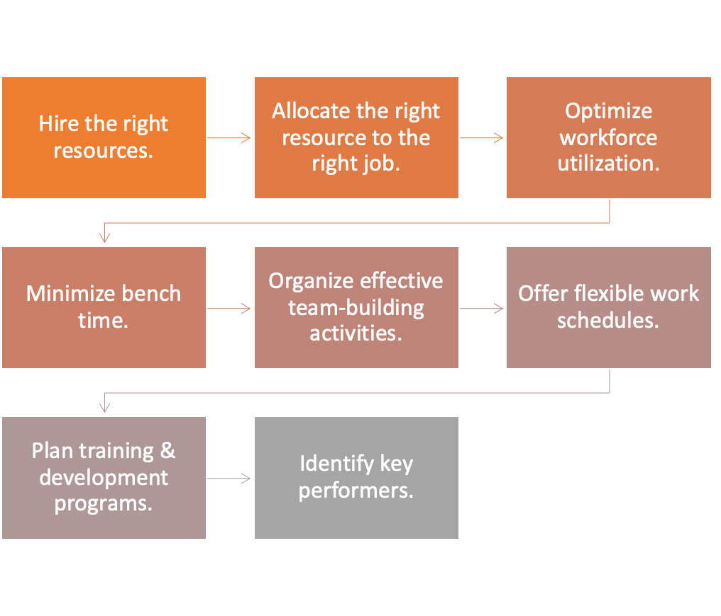
What do you plan to achieve with your project?

Slide 5

What is the primary goal of the project and how will it help the business?
Employee retention has one major goal: to keep the talented employees working effectively and happily at your company. But there are a variety of more specific objectives that tie into employee retention that may be worth a closer look and careful measuring as part of your overall employee retention strategy

Slide 6
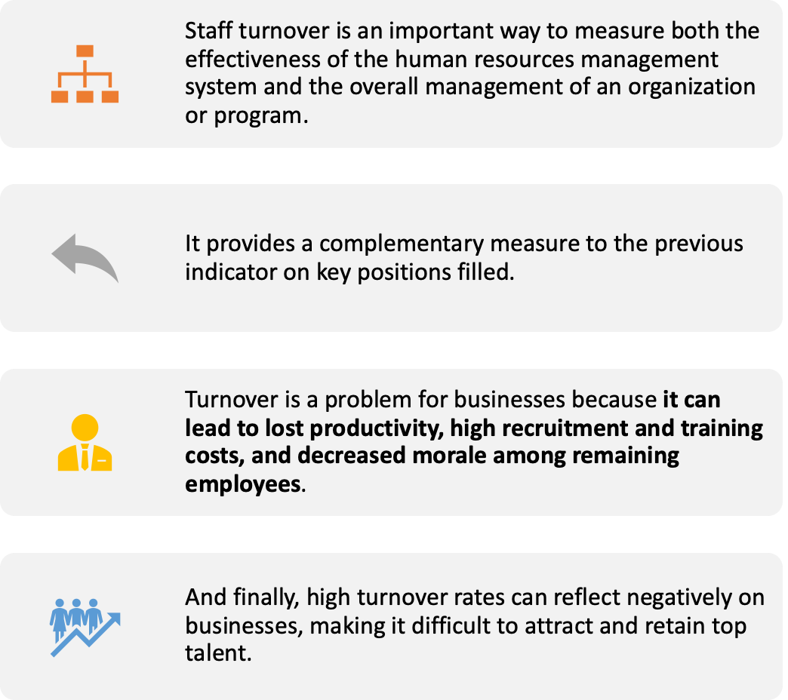
What are the implications of the project?

Slide 7
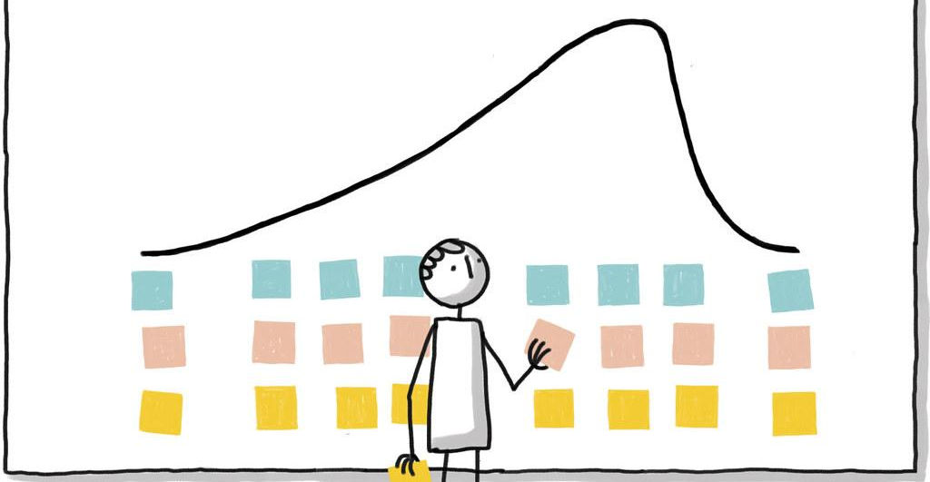
Describing Dataset

Slide 8


Where has the data been gathered?
Our data has been gathered from Kaggle. The data came with three csv files: test, train, and sample_submission. We used the train dataset which has the following variables:
Column Name | Description
Employee_ID | Unique ID of each employee
Age | Age of each employee
Unit | Department under which the employee work
Education | Rating of Qualification of an employee (1-5)
Gender | Male-0 or Female-1
Decision_skill_possess | Decision skill that an employee possesses
Post_Level | Level of the post in an organization (1-5)
Relationship_Status | Categorical Married or Single
Pay_Scale | Rate in between 1 to 10
Column Name Cont. | Description Cont.
Time_of_service | Years in the organization
growth_rate | Growth rate in percentage of an employee
Time_since_promotion | Time in years since the last promotion
Work_Life_balance | Rating for work-life balance given by an employee.
Travel_Rate | Rating based on travel history(1-3)
Hometown | Name of the city
Compensation_and_Benefits | Categorical Variable
VAR1 - VAR5 | Anonymised variables
Attrition_rate(TARGET VARIABLE) | Attrition rate of each employee

Slide 9
What are the input and output variables?
Y = 𝑓(𝑥) = 𝑏₀ + 𝑏₁𝑥 +.....𝑏n𝑥
Y is Attrition rate and input parameters were (EmployeeId, Age, Gender, Work Life Balance, Var2, Var4 etc.) used accordingly to the test conducted.
Our intention was to calculate the optimal values of the predicted weights 𝑏₀ and 𝑏₁ that minimize SSR and determine the estimated regression function

Slide 10

Descriptive Analysis

Slide 11
Number of columns and rows
Columns: 24
Rows: 7000

Slide 12
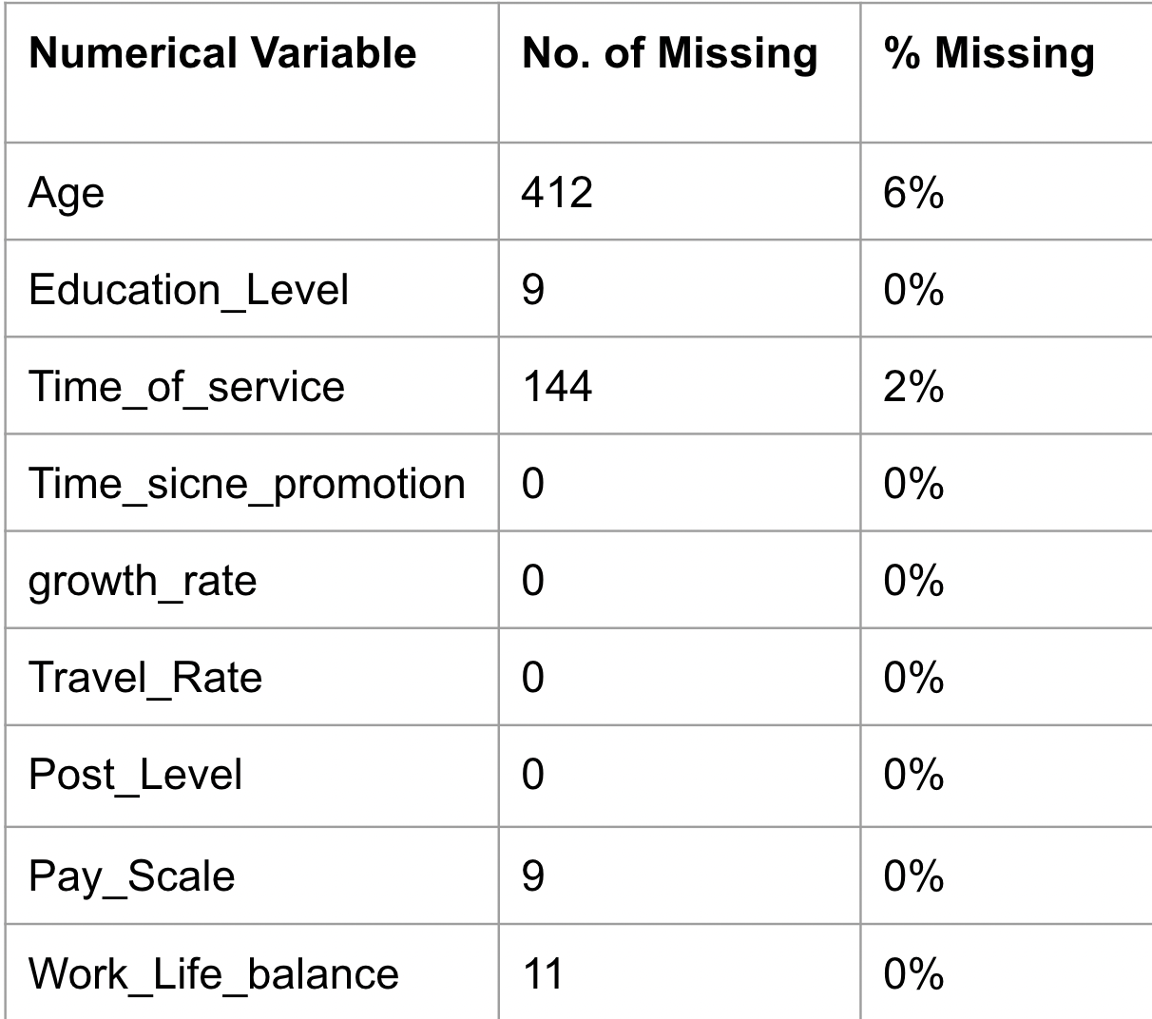
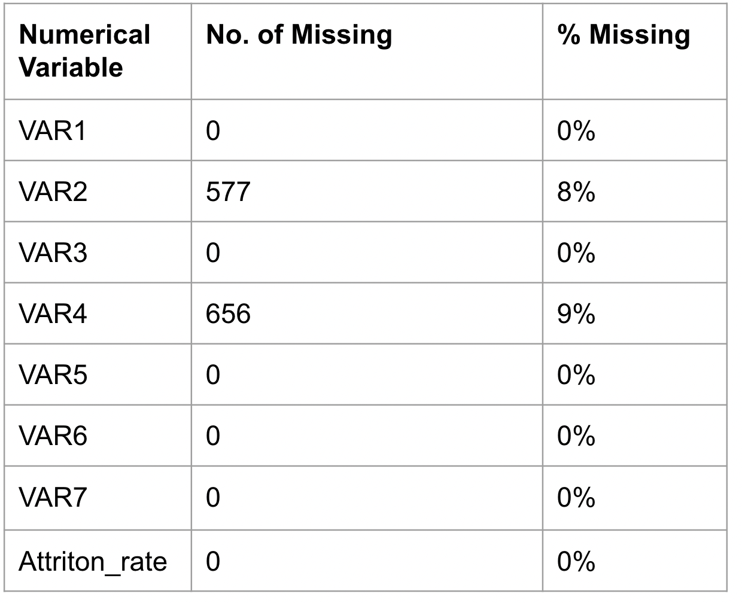
Percent of missing values by columns (Numerical Variables)

Slide 13

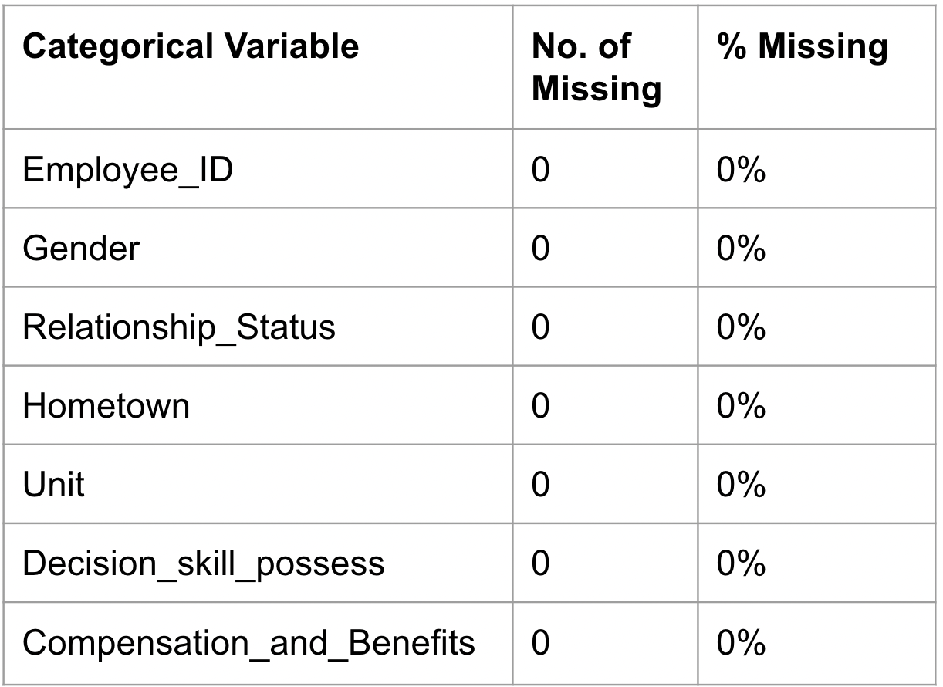
Percent of missing values by columns (Categorical Variables)

Slide 14
Means, Medians, Modes, Correlations, Variance, Outliers
Variable | Mean | Standard Deviation | Min | 25% | 50% | 75% | Max | Median
Age | 37.29 | 16.16 | 0 | 26 | 36 | 51 | 65 | 37
Education_Level | 3.19 | 1.07 | 1 | 3 | 3 | 4 | 5 | 3
Time_of_service | 13.11 | 10.43 | 0 | 5 | 10 | 20 | 43 | 10
Time_since_promotion | 2.37 | 1.15 | 0 | 1 | 2 | 3 | 4 | 2
growth_rate | 47.06 | 15.76 | 20 | 33 | 47 | 61 | 74 | 47
Travel_Rate | 0.82 | 0.65 | 0 | 0 | 1 | 1 | 2 | 1
Post_Scale | 2.80 | 1.16 | 1 | 2 | 3 | 3 | 5 | 3

Slide 15
Means, Medians, Modes, Correlations, Variance, Outliers (Continued..)
Variable | Mean | Standard Deviation | Min | 25% | 50% | 75% | Max | Median
Pay_Scale | 6.00 | 2.07 | 0 | 5 | 6 | 8 | 10 | 6
Work_Life_balance | 2,38 | 1.13 | 0 | 1 | 2 | 3 | 5 | 2
VAR1 | 3.10 | 0.84 | 1 | 3 | 3 | 3 | 5 | 3
VAR2 | -0.01 | 0.95 | -1.82 | -0.96 | 0.00 | 0.75 | 1.61 | -0.10
VAR3 | -0.01 | 0.99 | -2.78 | -0.45 | -0.45 | 0.71 | 1.87 | -0.45
VAR4 | 1.71 | 0.75 | 0 | 1 | 2 | 2 | 3 | 2
VAR5 | 2.83 | 0.94 | 1 | 2 | 3 | 3 | 5 | 3
VAR6 | 7.10 | 1.16 | 5 | 6 | 7 | 8 | 9 | 7
VAR7 | 3.26 | 0.93 | 1 | 3 | 3 | 4 | 5 | 3
Attrition_rate | 0.19 | 0.19 | 0 | 0.07 | 0.14 | 0.24 | 1.00 | 0.14

Slide 16
Findings
Gender | Count | Percentage
Female | 4114 | 59%
Male | 2886 | 41%
Age Group | Count | Percentage
2o and Below | 273 | 4%
AgeGrp20plus | 1915 | 29%
AgeGrp30plus | 1382 | 21%
AgeGrp40plus | 1215 | 18%
AgeGrp50plus | 1351 | 21%
AgeGrp60plus | 452 | 7%

Slide 17
Findings (Continued..)
Education Level | Count | Percentage
1 | 695 | 10%
2 | 691 | 10%
3 | 2878 | 41%
4 | 2076 | 30%
5 | 660 | 9%
Hometown | Count | Percentage
Lebanon | 2070 | 30%
Springfield | 1736 | 25%
Franklin | 1523 | 22%
Washington | 1106 | 16%
Clinton | 565 | 8%
Relationship Status | Count | Percentage
Married | 4520 | 65%
Single | 2480 | 35%

Slide 18
Findings (Continued..)
Unit | Count | Percentage
IT | 1394 | 20%
Logistics | 1173 | 17%
Sales | 943 | 13%
Operations | 706 | 10%
R&D | 680 | 10%
Purchasing | 504 | 7%
Accounting and Finance | 496 | 7%
Human Resource Management | 344 | 5%
Marketing | 212 | 3%
Production | 211 | 3%
Quality | 193 | 3%
Security | 144 | 2%

Slide 19
Findings (Continued..)
Decision Skill Possess | Count | Percentage
Conceptual | 1756 | 25.09%
Analytical | 1755 | 25.07%
Directive | 1753 | 25.04%
Behavioral | 1736 | 24.80%
Time of Service | Count | Percentage
5 Years | 1999 | 29%
5 to 10_Years | 1502 | 22%
10 to 15_Years | 917 | 13%
15 to 20_Years | 692 | 10%
20 to 25_Years | 647 | 9%
25 to 30_Years | 516 | 8%
30 to 35_Years | 337 | 5%
35 to 40_Years | 203 | 3%
40 Years | 43 | 1%

Slide 20
Findings (Continued..)
Time Since Promotion | Count | Percentage
1 | 1819 | 26%
2 | 1811 | 26$
3 | 1703 | 24%
4 | 1505 | 22%
0 | 162 | 2%
Compensation and Benefits | Count | Percentage
typ0 | 187 | 3%
typ2 | 3945 | 56%
typ3 | 2382 | 34%
typ4 | 353 | 5%
typ1 | 133 | 2%

Slide 21
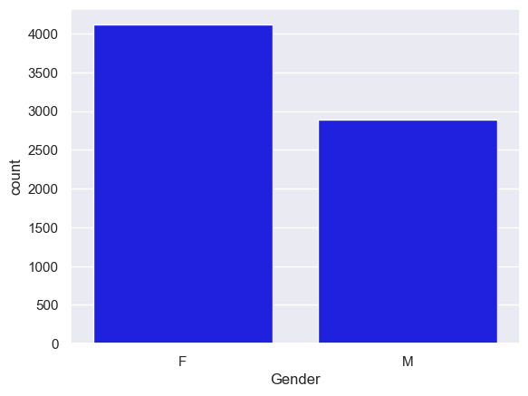
Visualization Bar Chart for Gender
Data Visualizations such as scatter plots or correlation plots

Slide 22
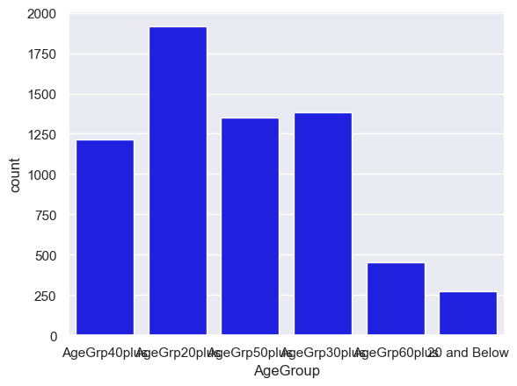
Visualization Bar Chart for Age Group
Data Visualizations such as scatter plots or correlation plots

Slide 23
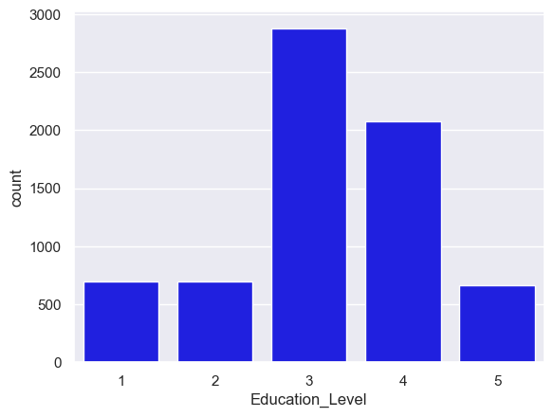
Visualization Bar Chart for Education Level
Data Visualizations such as scatter plots or correlation plots

Slide 24
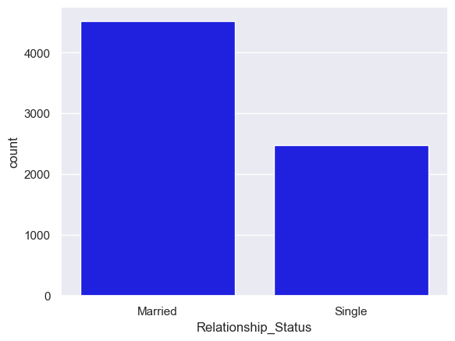
Visualization Bar Chart for Relationship
Data Visualizations such as scatter plots or correlation plots

Slide 25
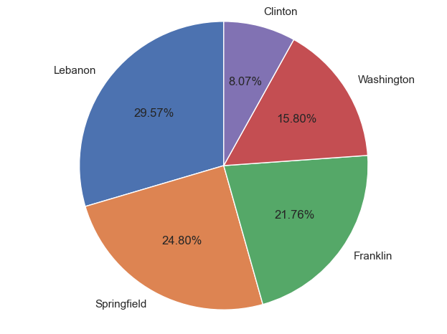
Data Visualizations such as scatter plots or correlation plots

Slide 26
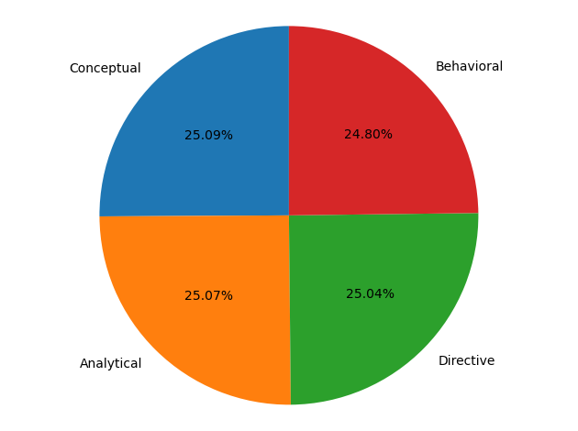
Data Visualizations such as scatter plots or correlation plots

Slide 27
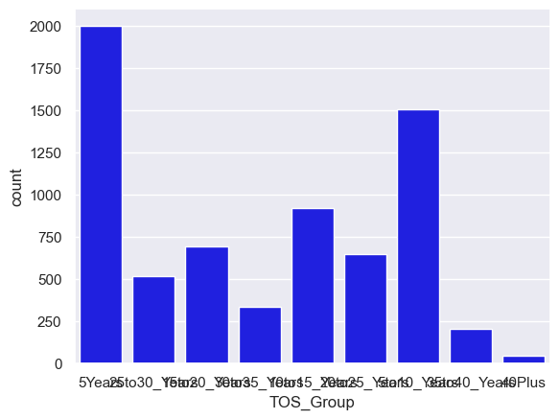
Data Visualizations such as scatter plots or correlation plots

Slide 28
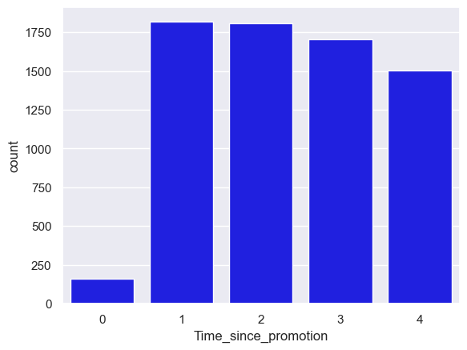
Data Visualizations such as scatter plots or correlation plots

Slide 29
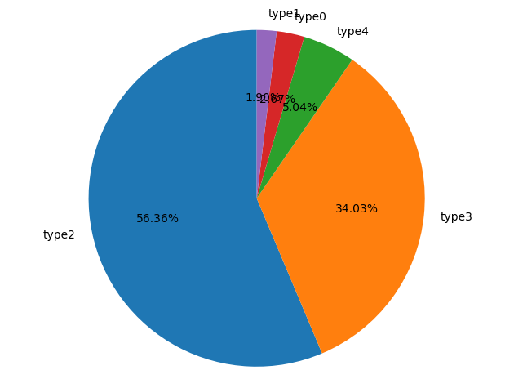
Data Visualizations such as scatter plots or correlation plots

Slide 30
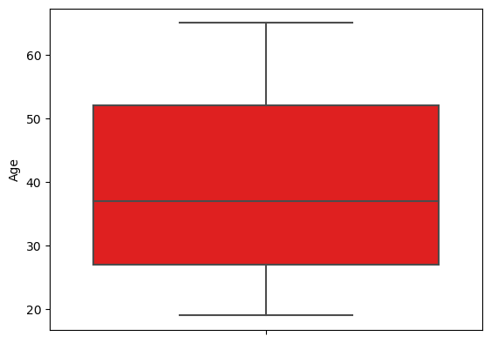
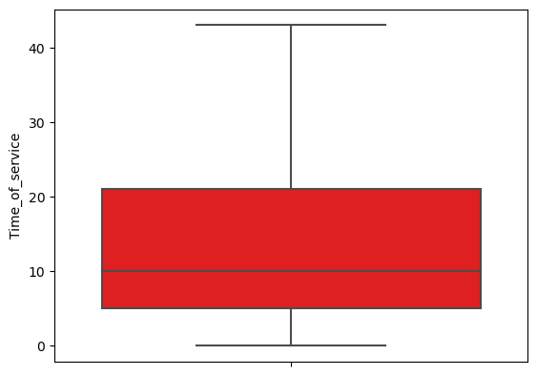
Detecting outliers using boxplot
Data Visualizations such as scatter plots or correlation plots

Slide 31
Detecting outliers using boxplot
Data Visualizations such as scatter plots or correlation plots

Slide 32
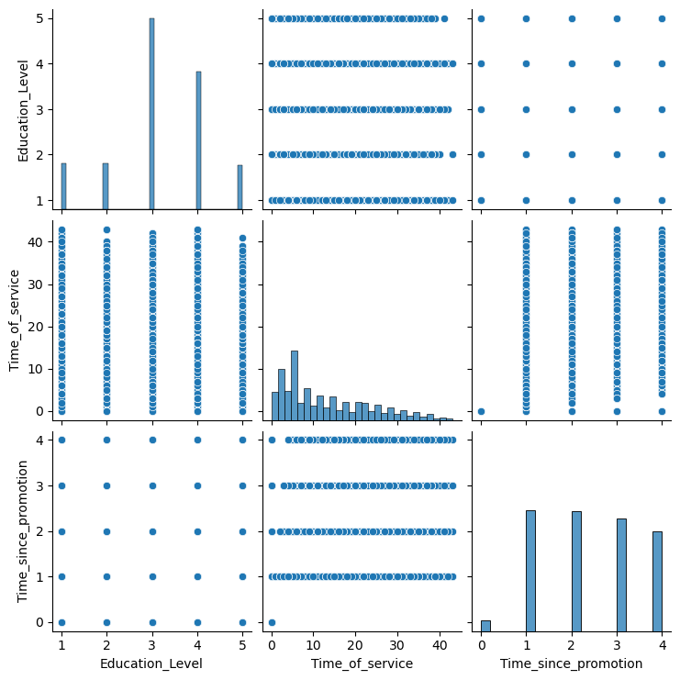
Pair plots for numeric variables
Data Visualizations such as scatter plots or correlation plots

Slide 33

Data Preprocessing
(Variable Treatment)

Slide 34
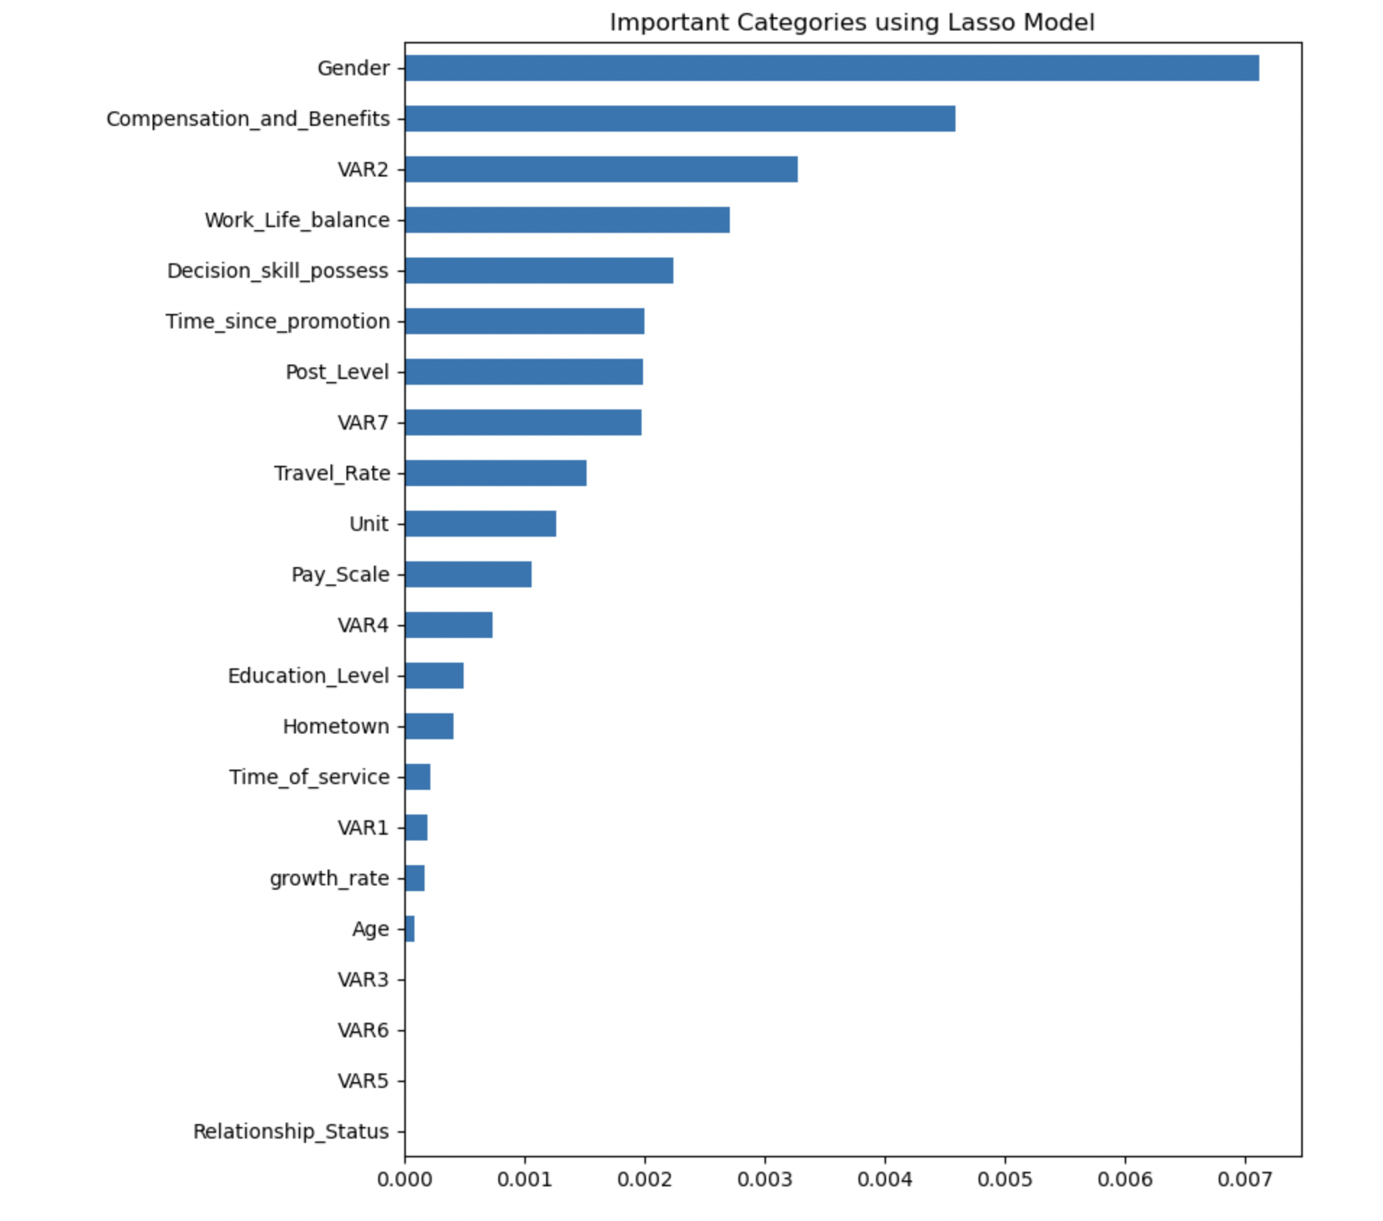
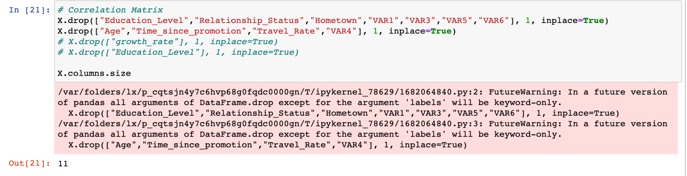
Dropping Columns & Rows
To determine which columns and rows are needed to be dropped used matplotlib to figure out which categories are highly correlated. Any category that was less than 0.001 we dropped.
Var 1, 3,4,5,6
Education Level
Hometown
Time of Service
Growth Rate
Age
Relationship Status

Slide 35
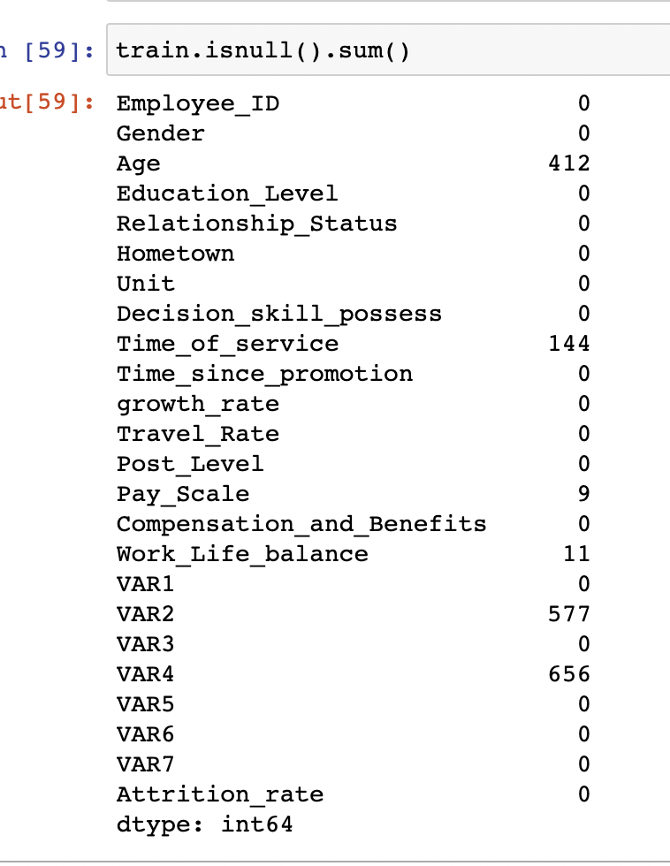
Imputing Missing Values
Used train.isnull( ).sum( ) to identify the rows with missing values.
Age
Time of Service
Work Life Balance
Var 2
Var 4

Slide 36
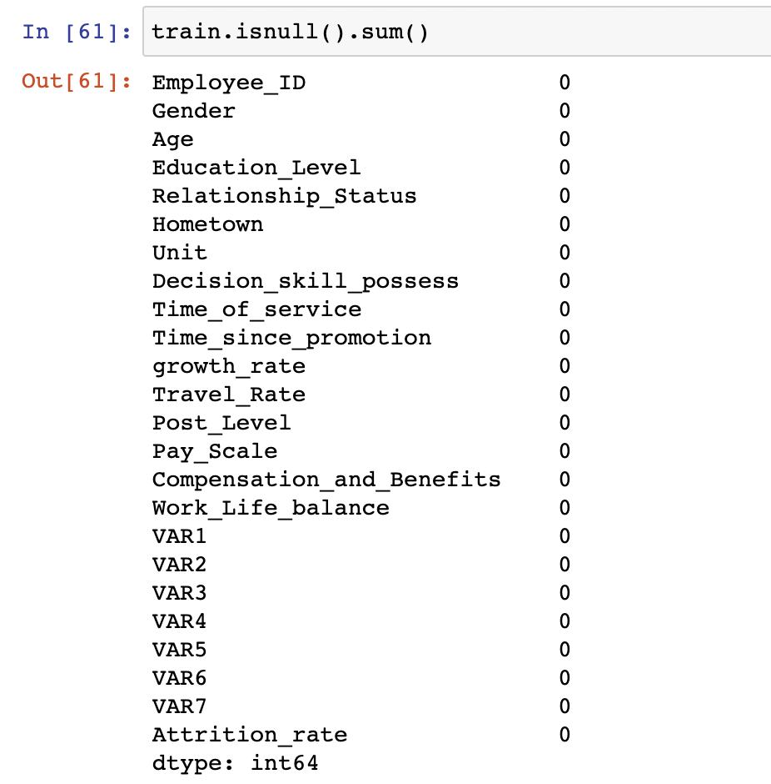
Imputing Missing Values
Replaced the null values with their mean values. The mean values will give better accuracy on the test dataset.
After replacing the missing values with the mean there are no more missing values and the now the dataset is more accurate.

Slide 37
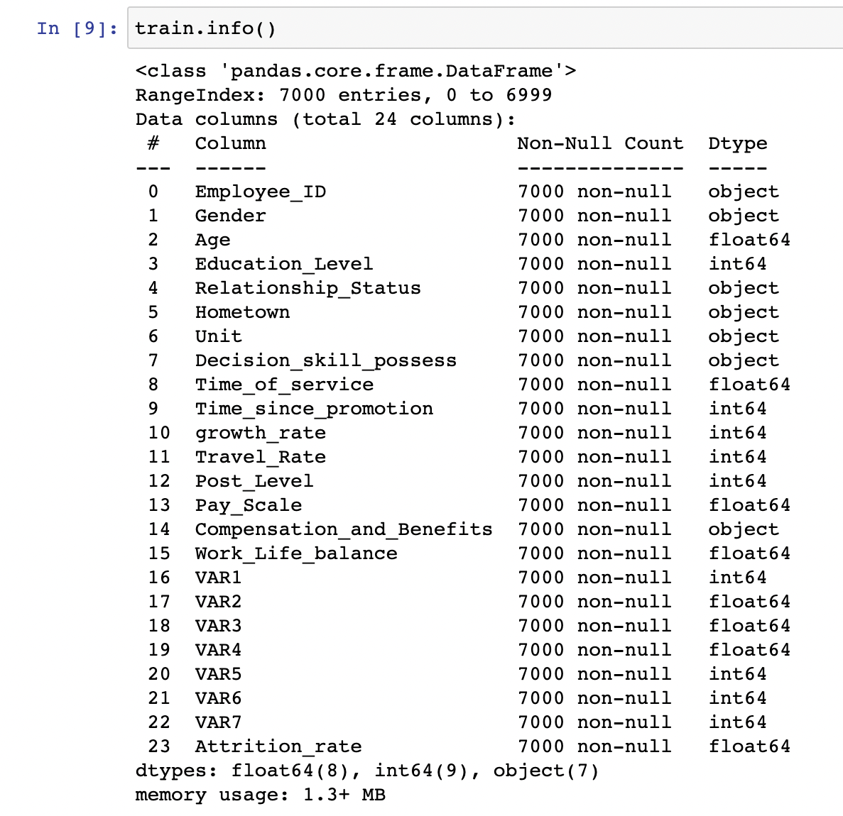
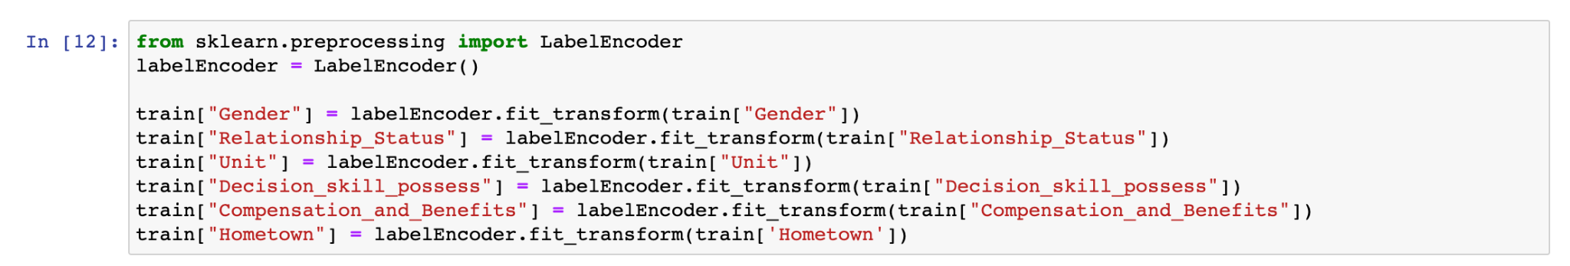
Transforming Variables
Defined the columns that needed to be changed from objects and transformed the variables to floats.
Gender
Relationship Status,
Hometown,
Unit,
Decision skill possess,
Compensation and Benefits.

Slide 38
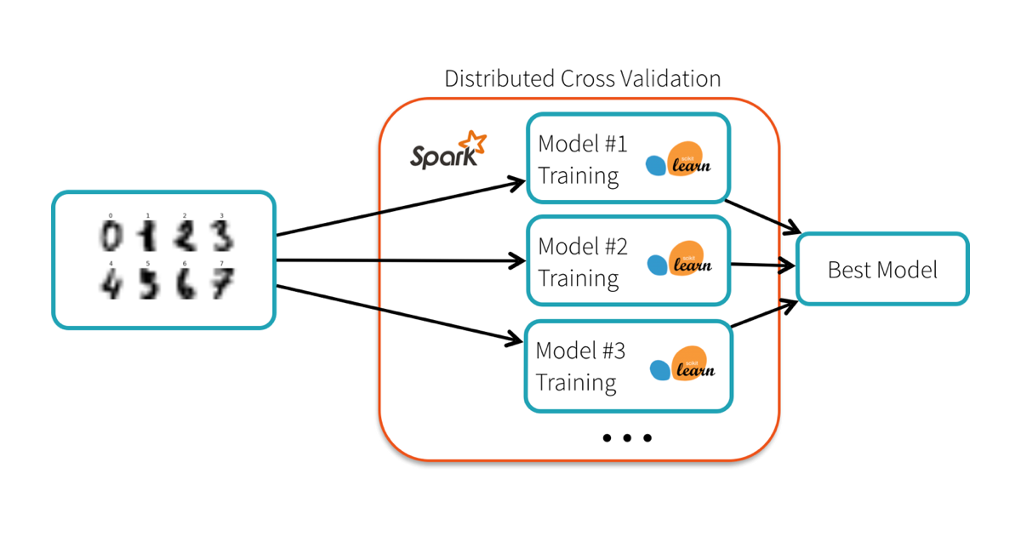
Data Preprocessing
(Fitting Models)

Slide 39
Fitting multiple models with varying parameters
Used seven different fitting models to determine which one is the best:
Random Forest
Linear Regression
Decision Tree
Gradient Boosting Regression
Ridge Regression
Lasso Regression
Elastic Net

Slide 40
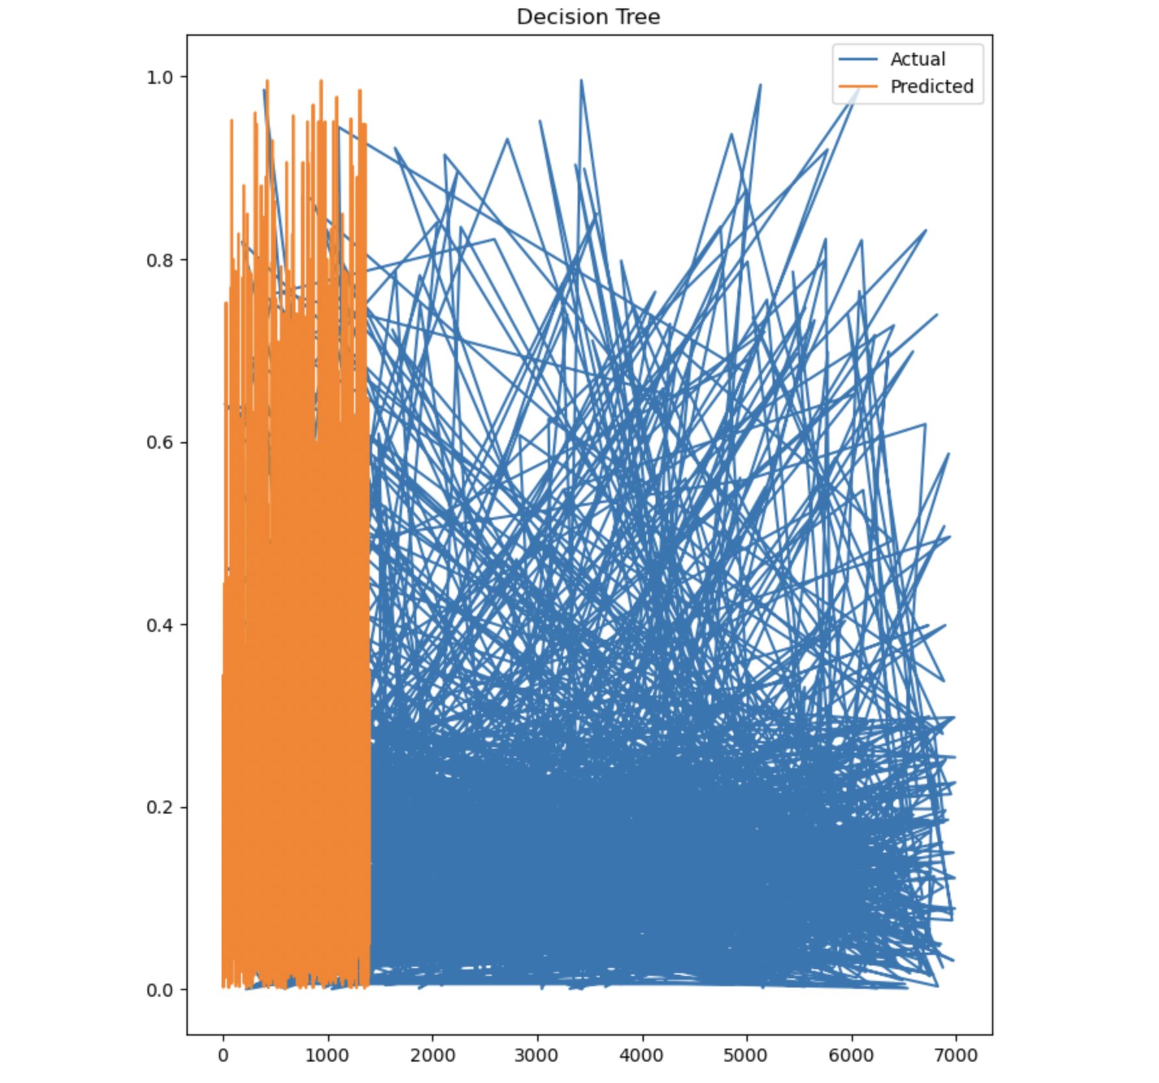
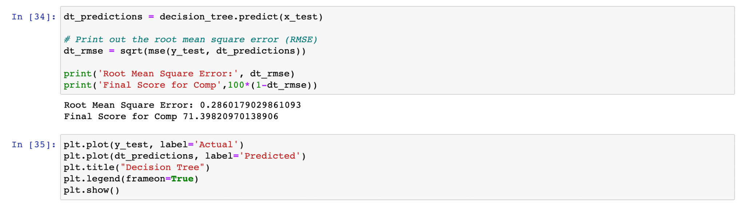
Summarize performance indicators of models
First we determined our x_train, x_test, y_train, and y_test to start performing our models.
After determining our x,y_test and x,y_train we imported all of the models into python. Then used the root mean square error function to determine how well does the model perform.
The model that performed the less was Decision Tree at 71.39%

Slide 41
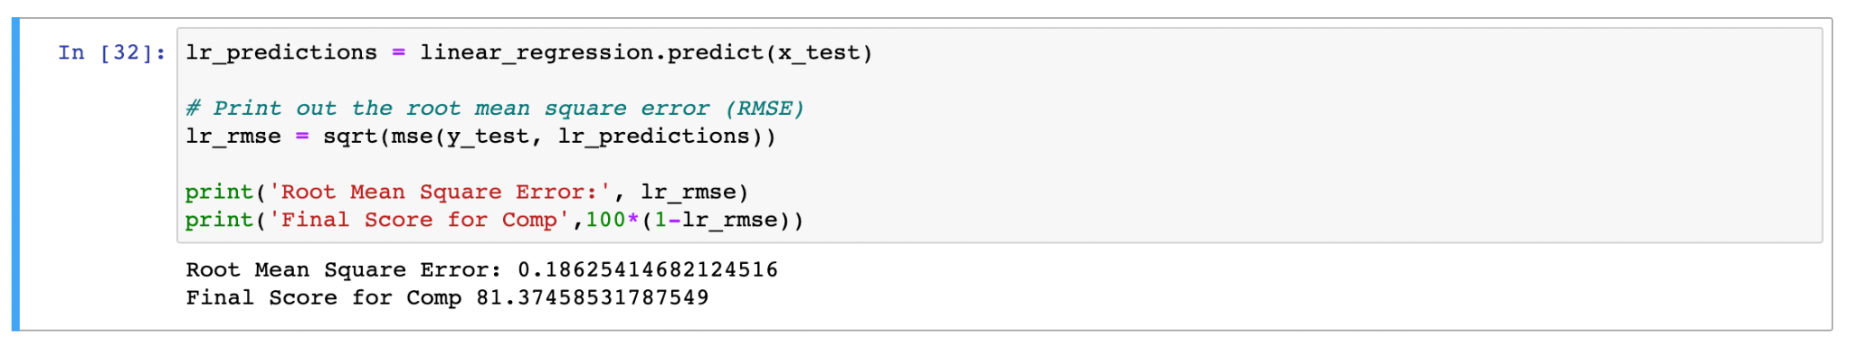
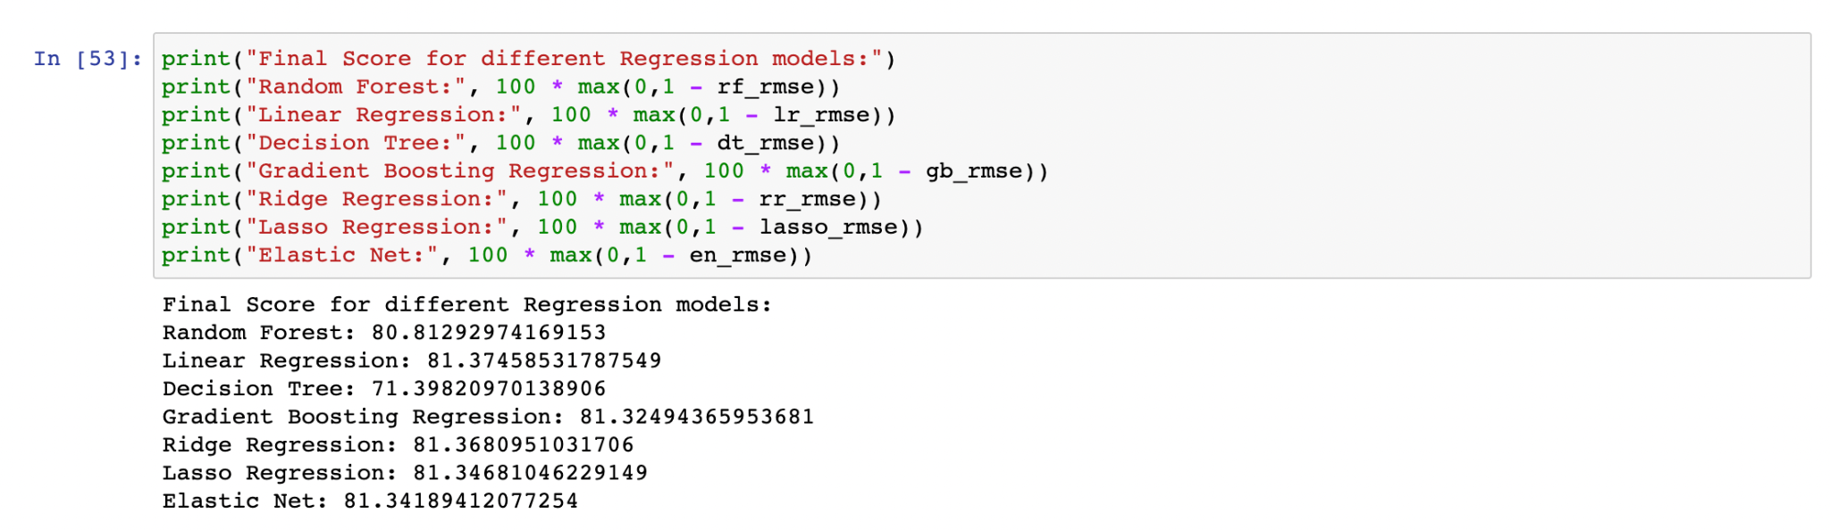

Selecting the best model using a test data set
Looking at the scores from all of the models ran it appears that they all have somewhat of a similar score. But, the model that best fits or performed well is the Linear Regression at 81.37%.

Slide 42

Thank
You

